Slide 1
06/14/22 EM Event
A Midwest Tragedy in 10 slides

Slide 2
What are we looking at?
Data provided
Consumed power (in kWh, where 1 kWh ≈ 1000 joules) over every 15 minute interval
Average wattage for a period can be found by multiplying by 4
Baseline
How does the customer’s rate of consumption (kW) compare to their expected/historical consumption?
Performance
How much power was the customer saving (providing to our resource pool)
Event overview
Over the course of 4 hours, how did customers perform given the outages?
How did each customer contribute to the dispatch?

Slide 3
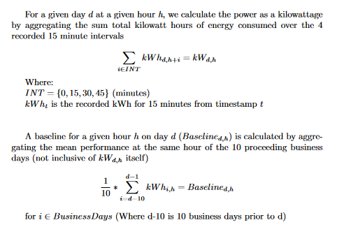
Average performance relative to baselines
What does this tell us?
The average performance of the customer over the course of the 4 hour event
Hour by hour analysis of their performance
10of10 baseline allows us to isolate each hour to a baseline that accounts for expected deviation of performance over the course of each hours
Fig 1: Baseline calculation methodology (made with LaTeX

Slide 4
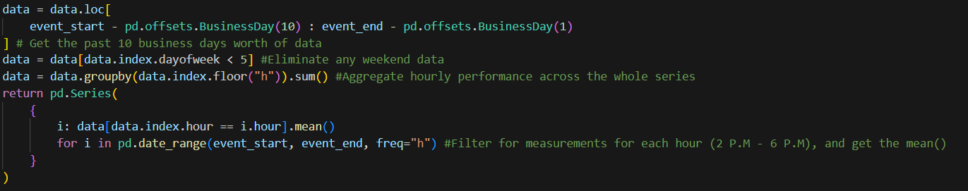
10of10 baseline calculation
Dates
Isolate our data to all recorded timestamps within 10 business days
Remove weekends and other events
No other given events during this span to remove, but event days should be omitted
Aggregate hourly wattage by taking the sum of kWh over each 15 minute interval / hour
Calculation
Filter for hours that match the event hour
Calculate the mean of the filtered series
Repeat for all 4 event hours
Fig 2: 10 of 10 baseline calculation implementation

Slide 5
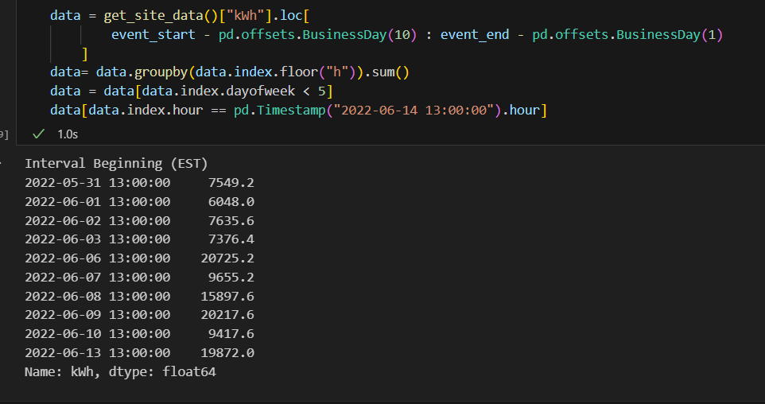
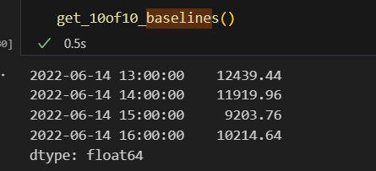
Fig 3 (Left): 10 of 10 hourly recorded wattage series for site 1
Fig 4 (Right): 10 of 10 baselines for site 1

Slide 6
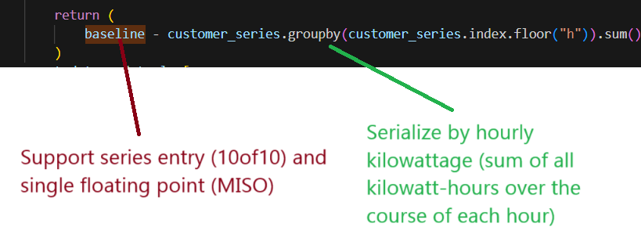
Baseline calculation implementation
Single, reusable function
Can accept any series of data as an argument
Any baseline as a constant floating point, or (matching indexed) series supported
Nuance
Requires pre-processing of data (you must filter the data to the desired date range)
Must provide the baselines as a pre-calculate argument
Fig 5: Customer average baseline calculation (MS Paint)

Slide 7
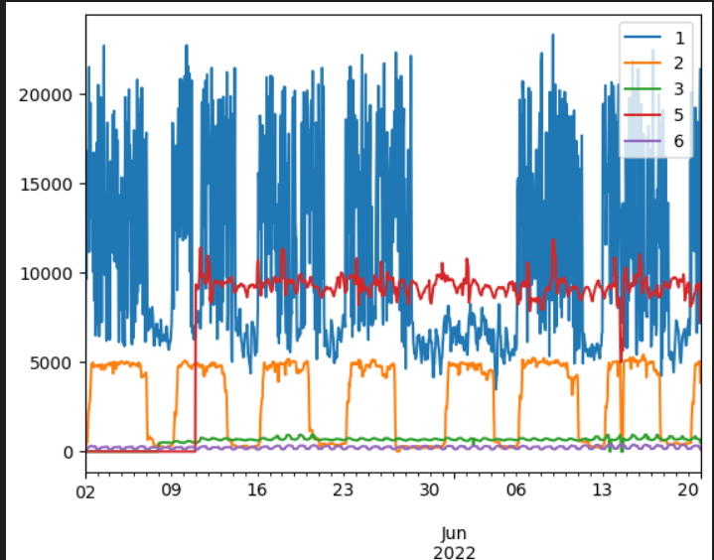
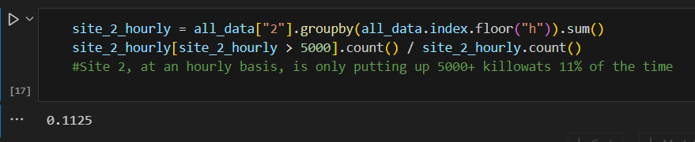
Size analysis and comparison
Site 1
Relatively higher numbers
The gap at the end of May/early June
Summer break before summer school
Site 2
Most consistent
Clearly defined troughs over weekends.
Limit of 5000, perhaps small office building
Fig 6 (Above): Hourly kilowatts for each site
Fig 7: Pandas functions to find % of measurements beyond 5000 on site 2

Slide 8
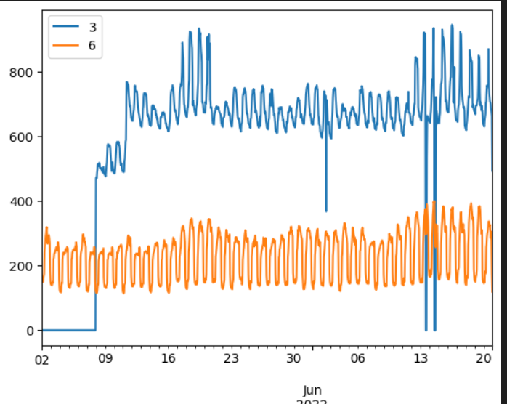
Site 3 and 6
Site 3 launched on 05/08
Site 3 and 6 seem to be serving residential neighborhoods
Increased energy usage after 5/6 P.M
when people come home, and the lights/TV/electronics come on)
Consistent daily oscillations
Both sites 3 and 6 have increased recorded consumption approaching the 14th.
Summer Solstice 1 week away (06/21(?)).
Increased AC usage combined with low grid output
Fig 8: Site 3 and 6 kilowatts over time

Slide 9
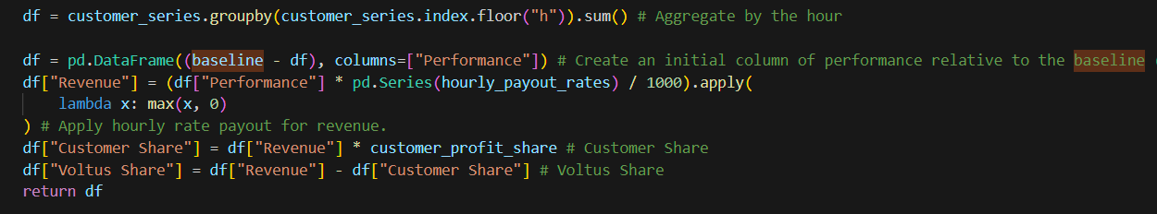
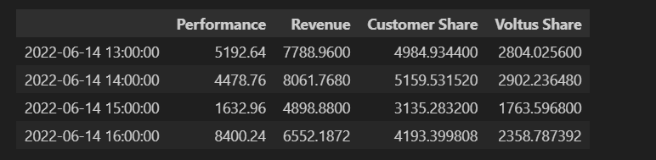
Part 3: Revenue and profit sharing
Fig 9: Revenue calculation function
Fig 10: Site 1 hourly revenue share table

Slide 10
Implementation, portability, scalability and improvements
Enable performance calculation with customizable
date/time range
Data set
Baseline arguments
Serializing functions
Avoid bottlenecks with iterative approaches
Restrictions
Argument must be formatted and indexed
Aggregate dataframe for multiple sites’ data must be calculated with separate function calls
Alternative: Object oriented approach
Each site is an object, with different calculation methods
Save series and mean calculations as instance variables
Can be stored in document based database
Avoid recalculation costs
Compute at construction
Can re-use different images/frames for future analysis
Improvement: Function Parameters
Date range arguments
Dataframe flexibility
Remove any direct ‘magic variables’ (accessing ‘kWh’ column)

Slide 11

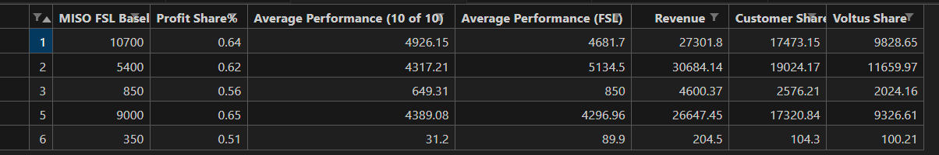
Results
Site 1, 5 significantly off of expected
20% margin for site 1 on both baselines
Site 2 within 100 watts of expected
Site 3 near perfect calculation
Site 4 continues to be awol
Sad!

